Slide 1


NEXT GEN EMPLOYABILITY PROGRAM
CREATING A FUTURE-READY WORKFORCE
Student Name :
E . Bhanu Prakash Reddy
Student ID :
College Name :
STU645f0974226a71683949940
Sphoorthy Engineering College

Slide 2
CAPSTONE PROJECT SHOWCASE
Project Title
Personal Finance Manager
Abstract | Problem Statement | Project Overview | Proposed Solution | Technology Used | Modelling & Results | Conclusion | Q&A

Slide 3
Abstract
1
Financial Challenge : Many people struggle with tracking expenses and budgeting, leading to financial stress.
2
Project Purpose : The Personal Finance Manager helps users manage income, expenses, and savings efficiently.
3
Key Features : It offers automated expense tracking, budgeting tools, and AI-driven insights for better planning.
4
Expected Impact : Users can improve financial habits and make informed money decisions.

Slide 4


Problem Statement
Challenges Faced by Users : Difficulty in tracking income and expenses Lack of awareness about spending patterns Inability to set and maintain a budget Missed bill payments leading to late fees Struggles in achieving long term financial goals
Impact :
Poor financial management can lead to overspending, debt accumulation, and financial stress, ultimately affecting an individual's financial well-being.

Slide 5

Project Overview
The Personal Finance Manager is a software solution that simplifies financial management by allowing users to : Monitor income and expenses in real-time Set up budgets and savings goals Receive AI-driven financial insights Get alerts for bill payments and overspending
This tool empowers users to take control of their finances by offering detailed spending reports, category-wise expense analysis, and personalized budgeting recommendations.

Slide 6
Proposed Solution
Our system helps users by:
Automating Expense Tracking: Transactions are categorized automatically
Providing Smart Budgeting Tools: AI suggests spending limits based on past habits
Generating Financial Insights: Helps users make informed financial decisions
Goal-Based Savings Management: Users can set and track financial goals
Alerts & Notifications: Reminders for bill payments and overspending prevention
By integrating AI and data analytics, the system ensures better financial discipline and planning.

Slide 7
Technology used
Tech Stack Backend: Python (Django/Flask) for server-side logic
Frontend: React.js or Flutter for an interactive UI
Database: MySQL/Firebase for secure financial data storage
AI & Data Analytics: Machine learning models for spending predictions and insights
Authentication: OAuth-based secure login for user safety
This combination ensures efficiency, security, and scalability in financial data management.

Slide 8

Modelling & Result

Slide 9
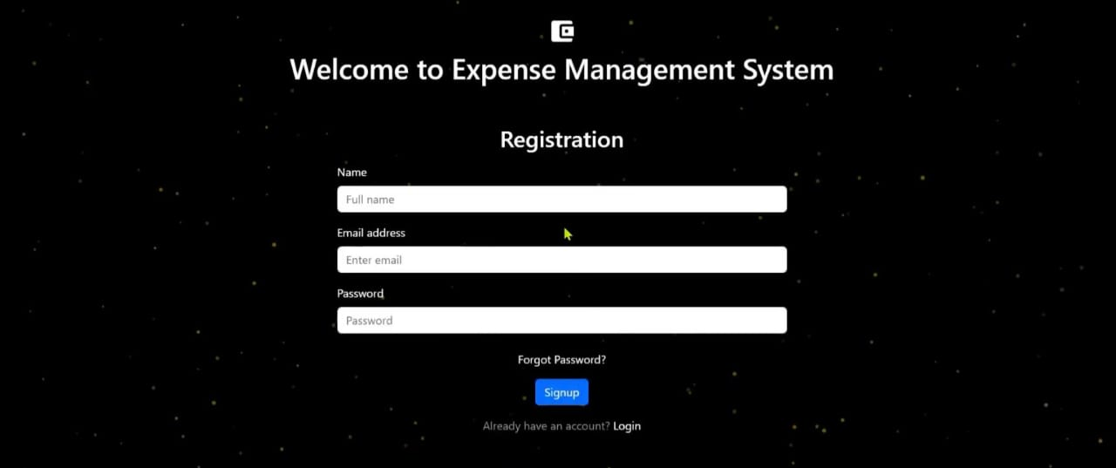
Modelling & Result

Slide 10
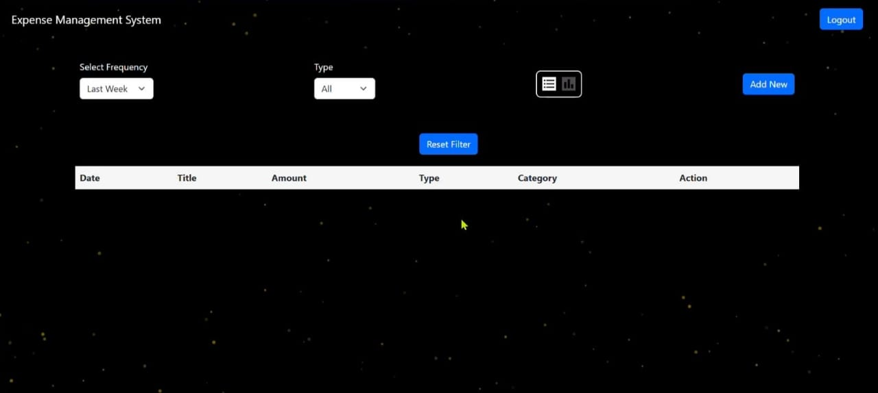
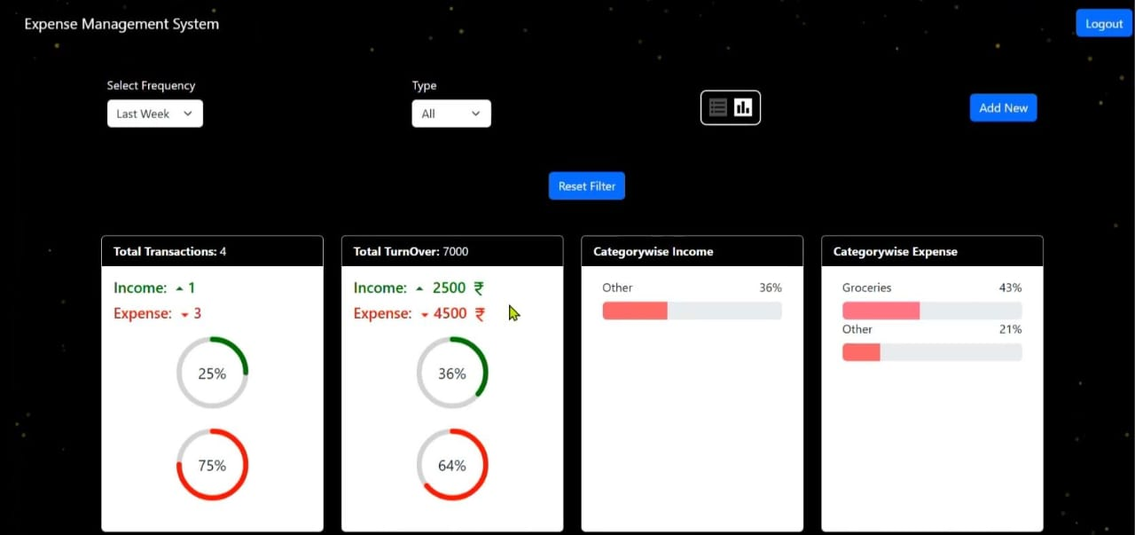
Modelling & Result

Slide 11

Conclusion
Key Takeaways : The Personal Finance Manager simplifies financial tracking and management
AI-powered insights enable better financial decision-making
Encourages disciplined spending and financial literacy
Future improvements include bank account integration, investment tracking, and credit score monitoring
Final Thought: This tool is designed to help individuals take charge of their financial future by offering personalized, data-driven financial planning.

Slide 12


Notes:
Thank You !!

